Slide 1
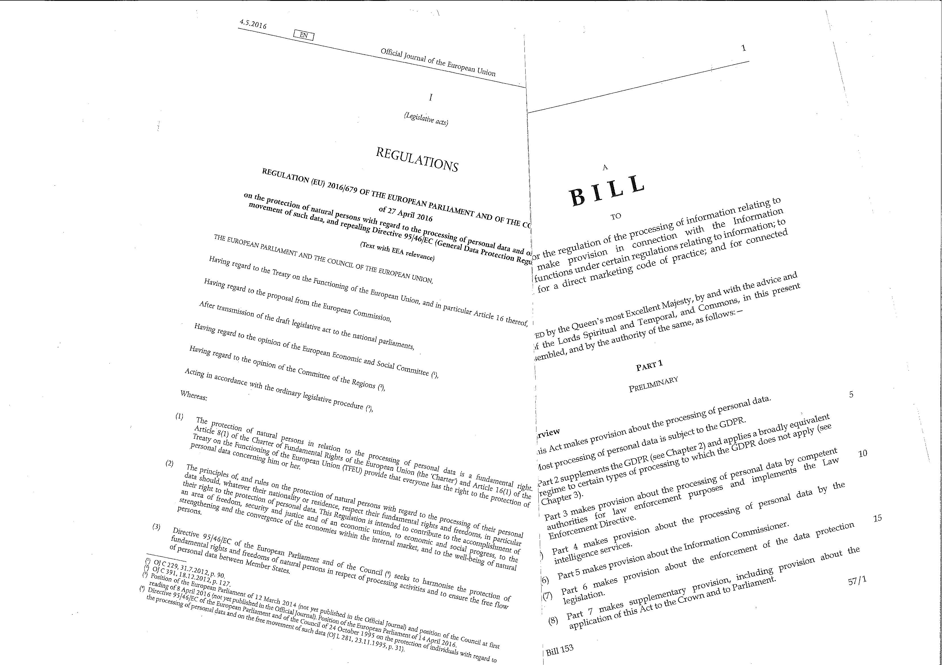
Data Protection Reform in Local Government

Slide 2
Transparency, Fair Processing, Privacy Impact Assessments, and Communication with the Public
David Roper-Newman
Craven District Council

Slide 3
GDPR Article 12
Transparent Information, communication and modalities for the exercise of rights of the data subject
Notes:
Modality – a particular way of doing or experiencing something also in music ‘the harmony had the touch of modality”!

Slide 4
Summary of Art. 12
Obligations of the data controller:
Provide information to the data subject where personal data is collected from the data subject;
Provide information to the data subject where personal data has not been obtained from the data subject;
Communicate: right of access, rectification and erasure, restriction of processing, data portability, objection to automated decision-making, and objection to profiling;

Slide 5
Summary of Art. 12 (cont’d)
Communicate details of a personal breach to the data subject (where it is likely to result in a high risk to the rights and freedoms of natural persons);
Facilitate the exercise of data subject rights;
Provide responses to requests within one month;
If unable to take action in the month, tell the data subject the reasons, and how to lodge a complaint with the ICO and/or seek a judicial remedy;

Slide 6
Summary of Art. 12 (cont’d)
Responses to be provided free of charge (unless requests are manifestly unfounded or excessive/repetitive);
Controller can seek to confirm the data subject’s identity;
Can provide information from privacy notices by standard icons.

Slide 7
Privacy Notices
ICO guidance (GDPR specific):
The GDPR includes rules on giving privacy information to data subjects in Articles 12, 13 and 14. These are more detailed and specific than in the current DPA and place an emphasis on making privacy notices understandable and accessible. Data controllers are expected to take ‘appropriate measures’.
https://ico.org.uk/for-organisations/guide-to-data-protection/privacy-notices-transparency-and-control/privacy-notices-under-the-eu-general-data-protection-regulation/

Slide 8
Example Privacy Notice
Privacy Notice – Craven Leisure Members
Details of the information that we collect from you, what we do with it, and who it might be shared with.
What information do we collect from you?
When you join as a member to use Craven Leisure’s services, we will collect your name, date of birth, contact details including home, email addresses and telephone number, and details of your next of kin. We will also take a photograph of your face. We will also ask for your bank account information. If you use the fitness centre, we will ask you for additional details concerning your health.
Why do we collect this information?
Your name and other identifying particulars are requested so as to enrol you to use the services on a regular basis at the Leisure Centre. Your bank account details are required so as to ensure that regular subscription payment arrangements can be set up via direct debit. Your next of kin is requested in case of any emergency at the Leisure Centre involving you. Your health details are required so that if you use the fitness centre, it is safe for you to use the equipment.
Who might we share this information with?
The Council will not share any of the information that it holds about you with any third party, unless you have given your written consent, or if otherwise this is permitted by law. If you make payment by debit or credit card, the information will be processed by banking services providers in accordance with the Payment Card Industry’s Data Security Standards. The Council has a formal contract with its data processor which helps the Council provide services to members of Craven Leisure.
What do we do with your information?
The information that you have provided will be held by the Council and will only be accessed by authorised Council employees. We will only use the information that you have provided for the purpose of your membership of Craven Leisure, and will not use it for any other Council purpose, unless we have your consent, or this is provided by law. We may separately ask you for your permission to provide you with information about other Council services, and if you agree, how you would like to receive that information. But you do not have to give your permission to receive these details, and it is not a condition of your membership of Craven Leisure that you agree.
How long do we keep hold of your information?
The Council will keep hold of your information for as long as you are a member of Craven Leisure. If you cease to be a member, we will retain your personal information for 2 years. Records of payments are retained for seven years in accordance with the relevant finance legislation.
How can I access the information you hold about me?
By making a Subject Access Request and going onto the Council’s website at http://www.cravendc.gov.uk/article/381/Data-Protection or writing to the Data Protection Officer, Craven District Council, First Floor, Belle Vue Square, Broughton Road, Skipton, BD23 1FJ. A fee of £10 is payable if a request is made before 25 May 2018.

Slide 9
Data Protection Impact Assessments (DPIAs)
Already covered in a previous session
Full guidance on the ICO website, including template to use:
https://ico.org.uk/for-organisations/guide-to-the-general-data-protection-regulation-gdpr/accountability-and-governance/data-protection-impact-assessments/

Slide 10
DPIAs (Cont’d)
DPIAs help organisations to identify the most effective way to comply with their data protection obligations and meet individuals’ expectations of privacy.
DPIAs can be an integral part of taking a privacy by design approach.
The GDPR sets out the circumstances in which a DPIA must be carried out.
(ICO website)

Slide 11
DPIAs (Cont’d)
When? (Art. 35)
(Before) where processing is likely to result in a high risk for the rights and freedoms of natural persons.
DPO to be consulted.
ICO to publish examples of processing operations that will require a DPIA.
Must consult ICO if DPIA indicates high risk remains despite measures taken to mitigate (Art. 36).

Slide 12
DPIAs (Cont’d)
DPIAs must be undertaken in the following cases:
Systematic and extensive evaluation of personal aspects based on automated processing, including profiling, and on which decisions are based that have a legal impact on people;
Processing on a large scale of special categories of data (health, racial/ethnic origins, sex life, political opinions, biometric data, etc);
Systematic monitoring of a publicly accessible area on a large scale.

Slide 13
DPIAs (Cont’d)
Content of DPIA - Art.35 (3) – use ICO’s guidance;
Prior consultation with the ICO if needed (Art 36);
Data Protection by Design/Default (Art. 25);
Useful information and other resources to assist with DPIAs from the French National Data Protection Commission (CNIL): https://www.cnil.fr/en/home

Slide 14
Contact: David Roper-Newman, 01756 706336 email: droper-newman@cravendc.gov.uk

